Slide 1
Caviar analysis
Kevin Li

Slide 2
Data Integrity
Data was first tested and cleaned for integrity issues.
Date/Time variables were converted to Date/Time format.
Remove occurrences where total pickup wait time is greater than three hours.
Remove circumstances when price was recorded as 0. (Needs to further investigate merchant 118)
Remove circumstance when delivery time from merchant exceeds 4 hours.
Time zones were best approximated to the local time zone.

Slide 3
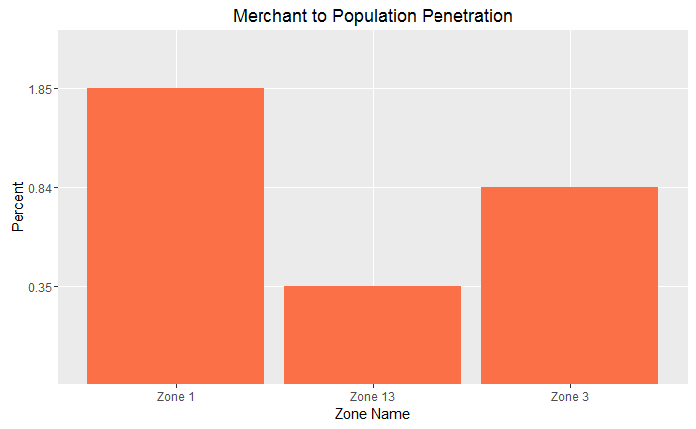
Growth, demand and merchant analysis
Zones 1 and 3 are performing higher than zone 13 in terms of merchants/population ratio.
Consider increasing merchant incentives to grow merchant size in Zone 13.
Deliveries growth MoM is slower in Zone 13 (17%) than Zones 1 (32%) and 3 (32%).
Consider programs to incentive user growth in slower areas.
Demand/Population is highest in Zone 1.
Consider improving demand in Zones 3 and 13 through consumer incentives.
Service Region | Month | Deliveries | Growth | Demand/Population
1 | October | 6717 |  | 0.746%
1 | November | 9910 | 32% | 1.101%
3 | October | 3559 |  | 0.341%
3 | November | 5204 | 32% | 0.498%
13 | October | 945 |  | 0.158%
13 | November | 1145 | 17% | 0.191%

Slide 4
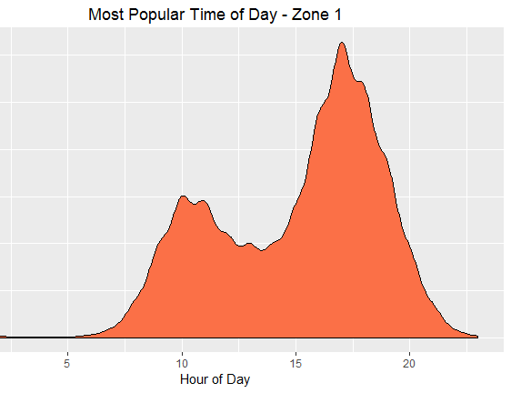
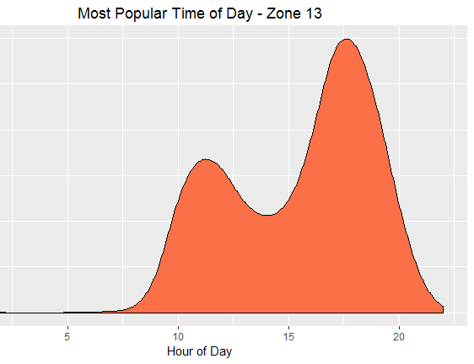
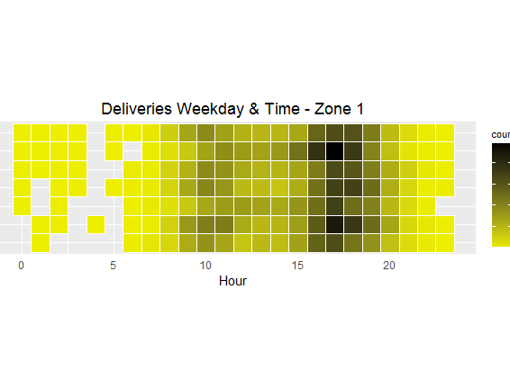
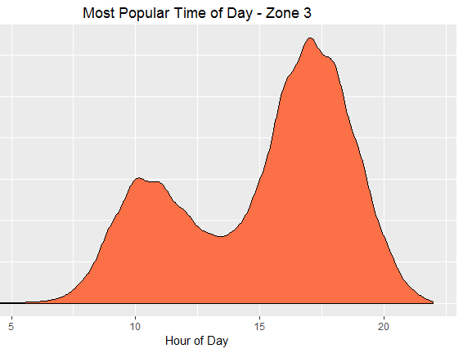
Peak Hours and days
Most popular time of day for deliveries are during noon and dinner time.
Possible pricing strategy by demand.
Can recommend more carriers to be available during peak hours/days.
*time zones are standardized through estimation (assuming peaks should occur during lunchtime and dinner time)

Slide 5
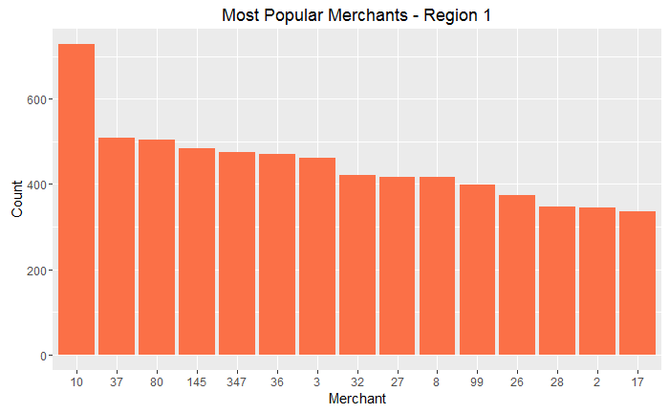
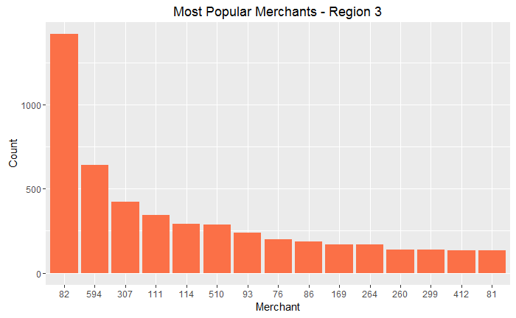
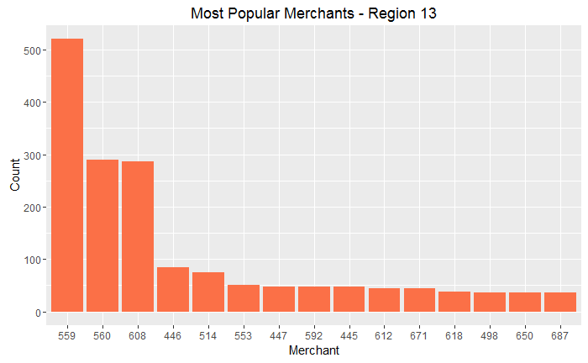
Increasing Merchant popularity
Merchant popularity is distributed more equally amongst merchants across Region 1. (Region 1 is also the best performing)
A more logarithmic distribution is shown for Regions 3 and 13.
Overall performance of markets 3 and 13 can potentially increase if distributions were better distributed.
Potential case to feature less popular merchants on front page of app. A/B test performance.

Slide 6
Thank you
*Further analysis is included in the R-Markdown file.

